Slide 1
Using Edublogs.org
First, visit the site and sign up. It is FREE.
It requires you to provide:
1. an email account
2. a username (to access your blog)
Your username should be:
First Name, last name initial, class period #
For example: BillyS6
3. a unique password (to access your blog)
Your email is used to send you notifications about activity on your blog
(i.e., new comments)

Slide 2
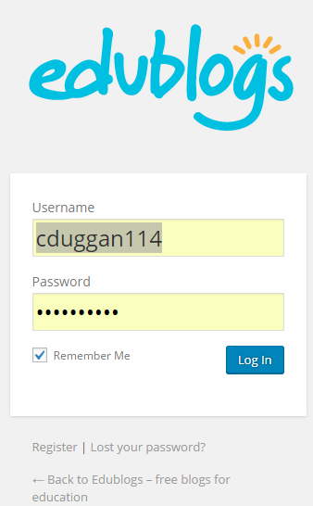
Step 1: www.edublogs.org and sign in using your username and password.

Slide 3
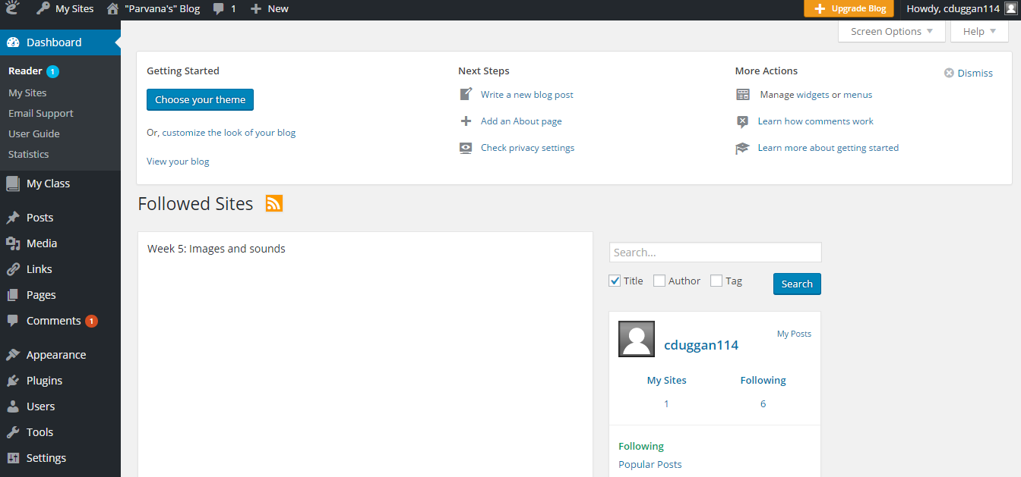
This page is called your DASHBOARD. You will use the dashboard to customize your blog, most importantly, by adding new posts. *There are a number of things on the dashboard that YOU WILL NOT NEED. The links that have arrows pointing to them are the main links that you’ll use throughout this assignment.

Slide 4
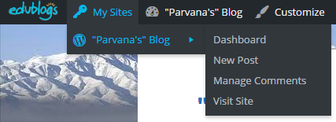
By scrolling over this link, you can…
This link will simply bring you to your blog’s site (same as last link below).
Return to Dashboard to edit content or design
Write new blog post – go to blog
editor page
View/approve/delete comments on any of your posts
View your blog’s site

Slide 5
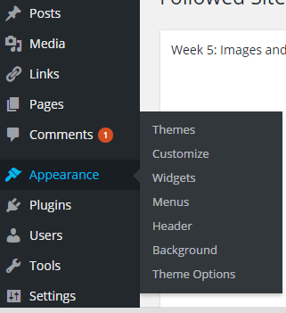
To customize appearance….
Step 2
Step 1

Slide 6
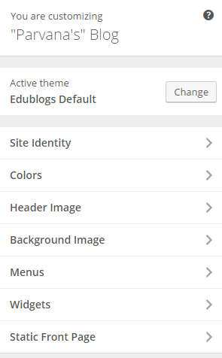
After you click on “Customize,” you’ll be here, where you can find the links to everything
you can personalize on your blog.
1. Refers to what you’d like to title your blog. Notice, I used the name “Parvana’s Blog”
2. Play around with color schemes.
3. Choose or upload header image.
4. Choose or upload background images (your background will be like a “wallpaper.”
Do not worry about using
these links!

Slide 7
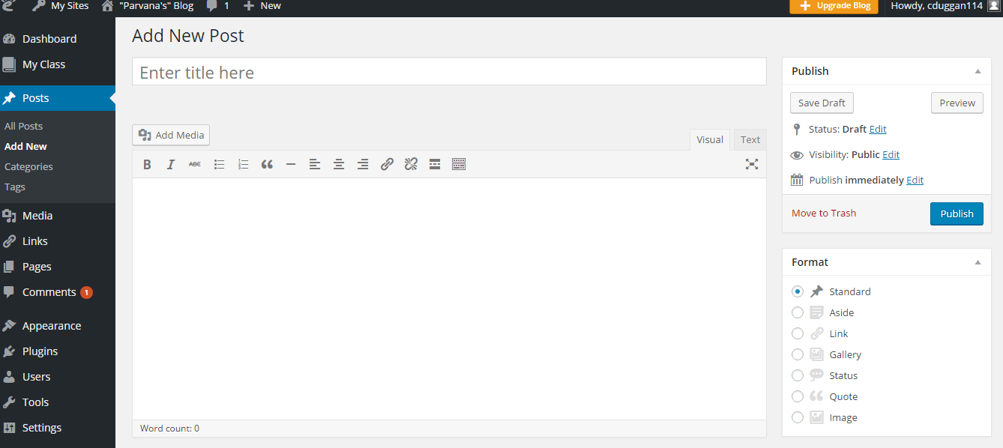
Type directly in text box to title
your blog post. It can be simple
(Chapter 5), or more creative (“My
Day in the Marketplace”)
Click this link to upload images
Type directly in this space to write your blog.
Click when ready to post!
Note: Blog posts are always
Able to be edited. *See me if you have questions about how to do that!

Slide 8
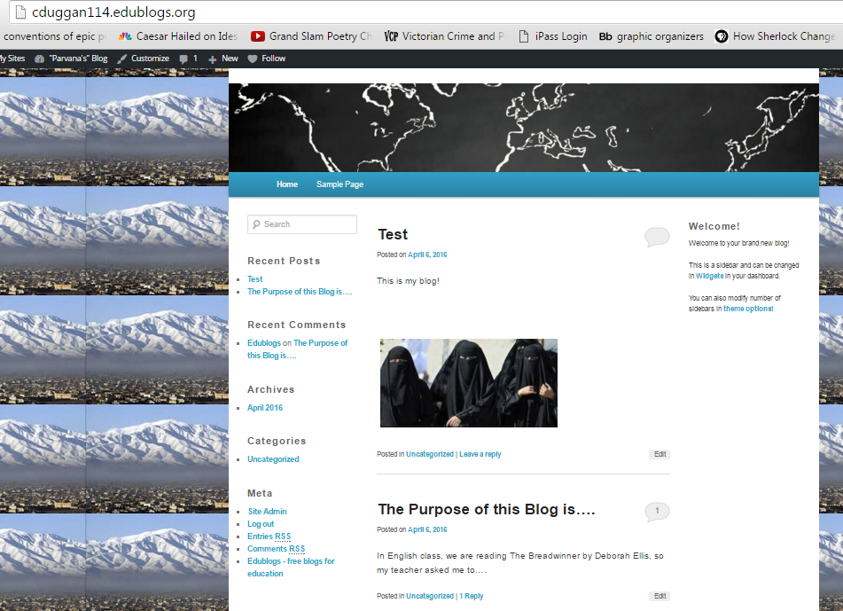
Here’s what your blog looks like once posted! Links are organized from newest (top)
to oldest (bottom).
URL for others to get to your blog
Blog title
Blog content
Older posts are at the bottom

Slide 9
Note: We are UNABLE to make your blog password protected or shown
to a limited audience. Therefore, it is essential that you
DO NOT use your full name in your blog posts, anywhere on your site,
and when you comment on others’ blogs.
Additionally, anyone who is irresponsible or inappropriate when
commenting on other students’ work will be given a ZERO on this
assignment, and will likely lose access to using the iPads during our
iMovie research project. Be responsible Internet users!

